Slide 1
WIRESHARK NETWORK ANALYSIS WIRESHARK ANALYZE OF MALICIOUS TRAFFIC
PRESENTED BY: MD IFTAKHER HOSSAIN

Slide 2
Slide Title
Time thieves watching YouTube during working hours
Windows host infected with virus
Illegal downloads

Slide 3

Wireshark
Protocols in use
Network activity, web browsing, downloading files via FTP, torrenting
Number of machines sending traffic

Slide 4
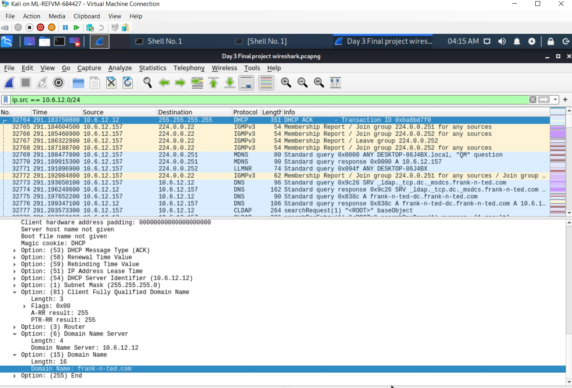
Wireshark-Time Thieves
Domain Name: frank-n-ted.com
Domain Controller IP: 10.6.12.12

Slide 5
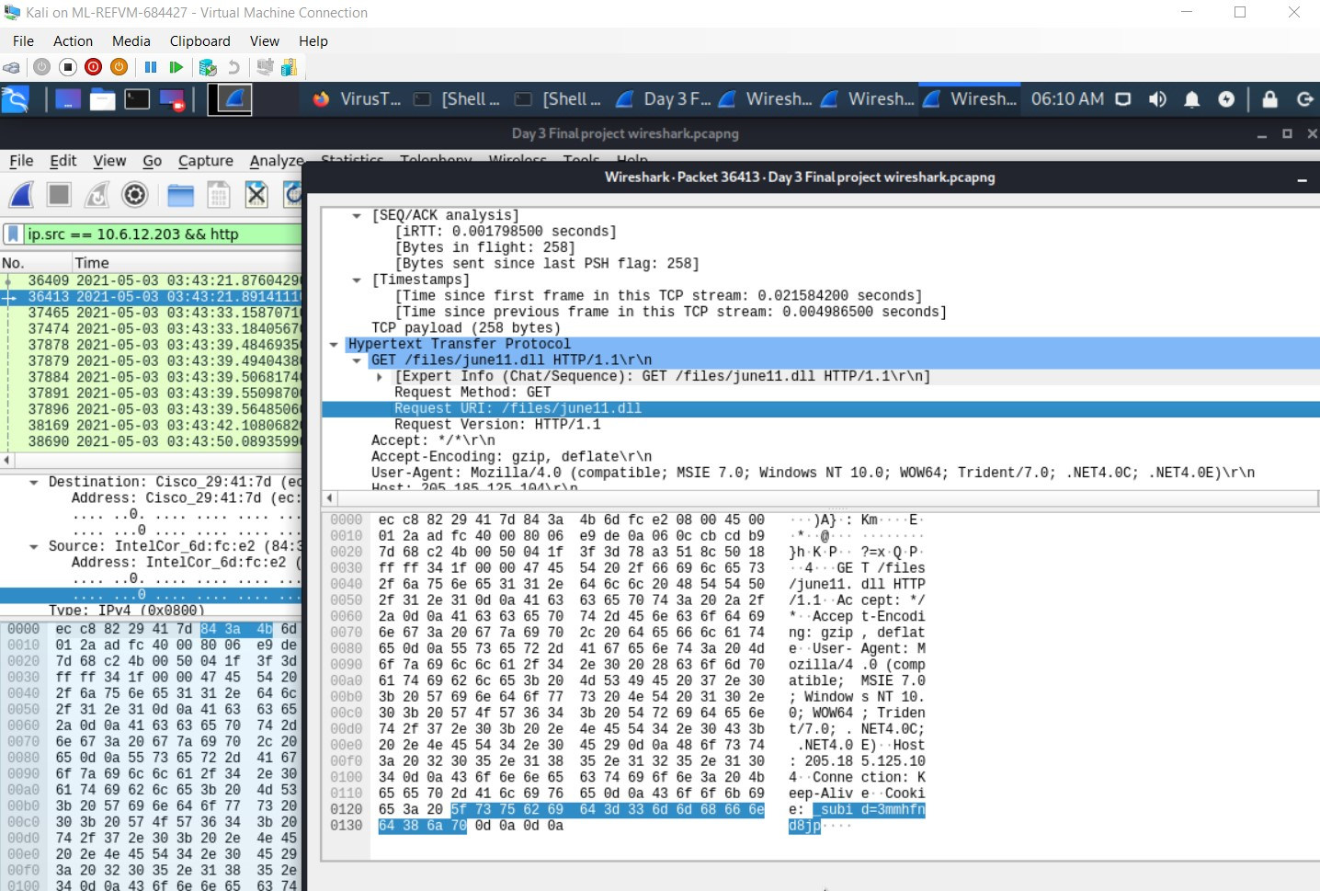
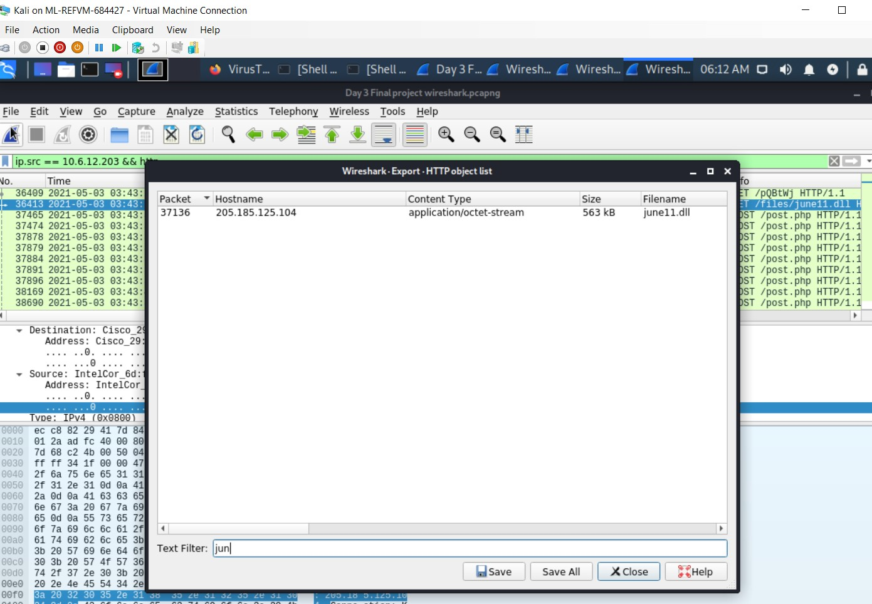
Wireshark-Time Thieves
Malware downloaded to 10.6.12.203 june11.dll

Slide 6
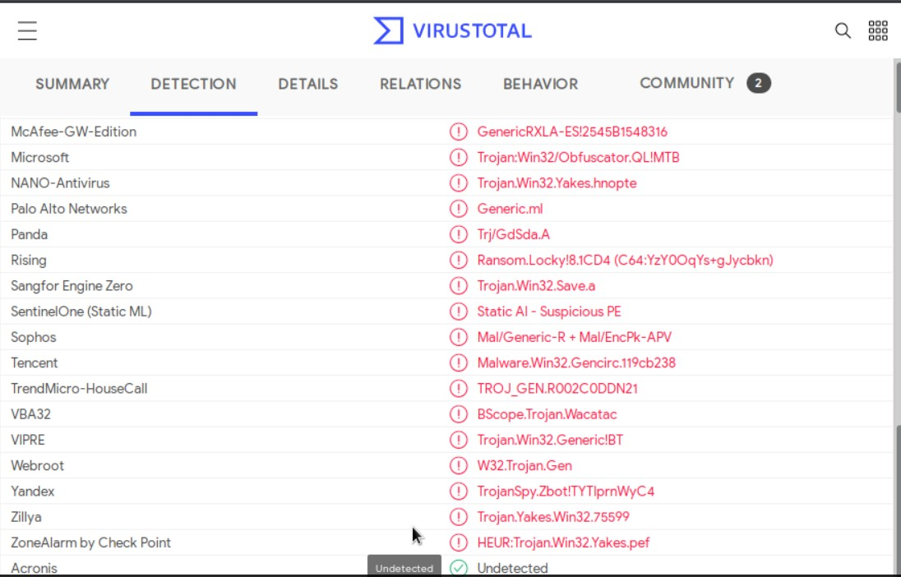
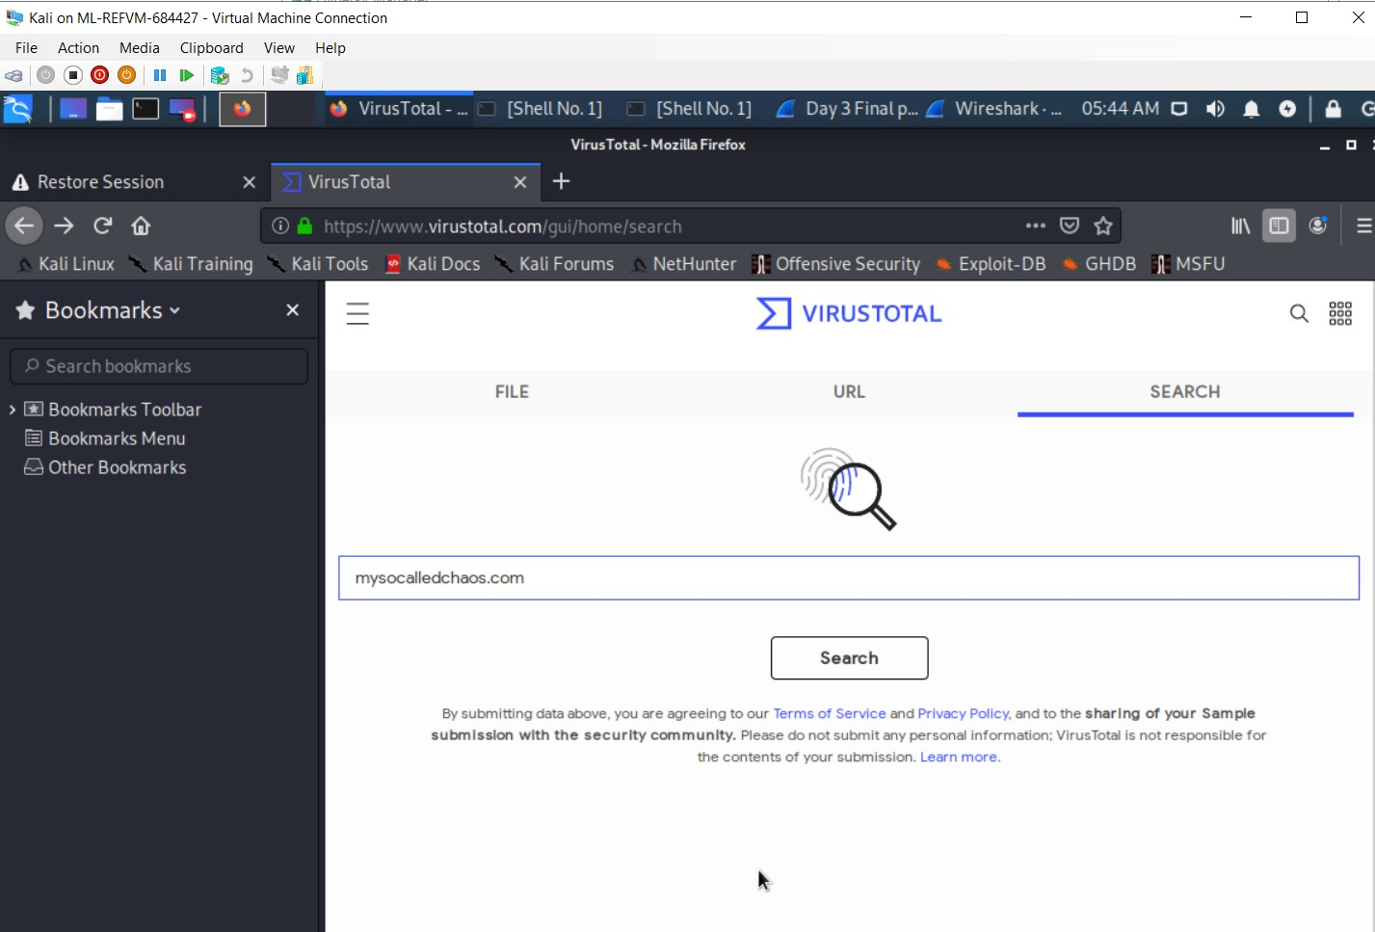
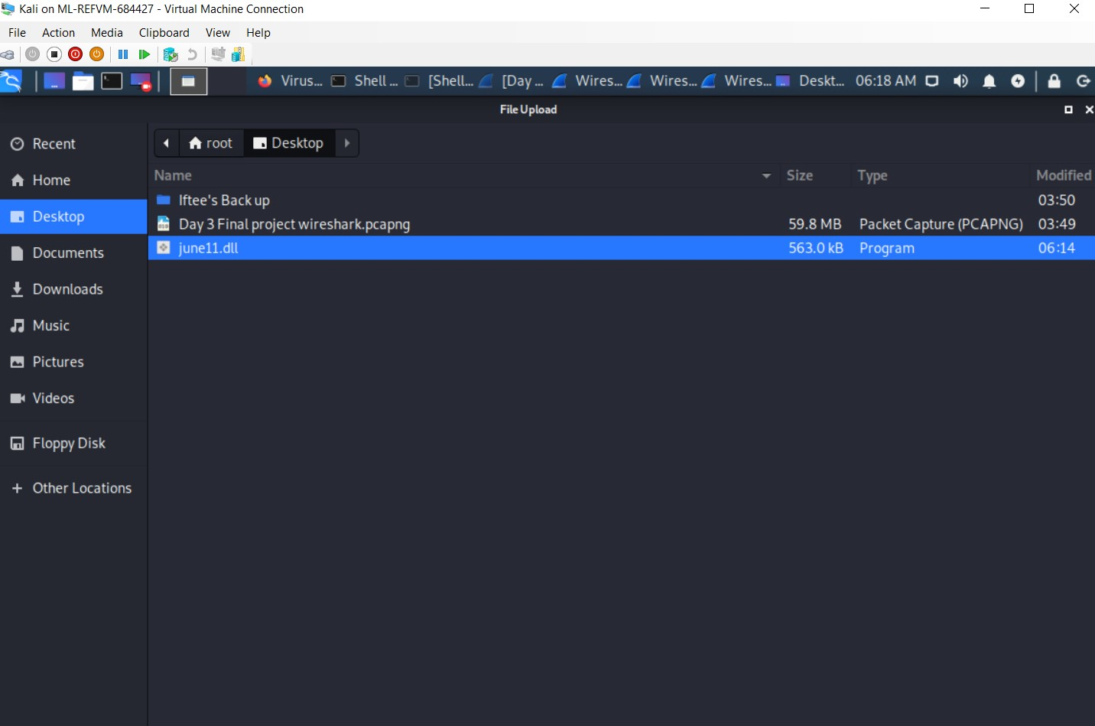
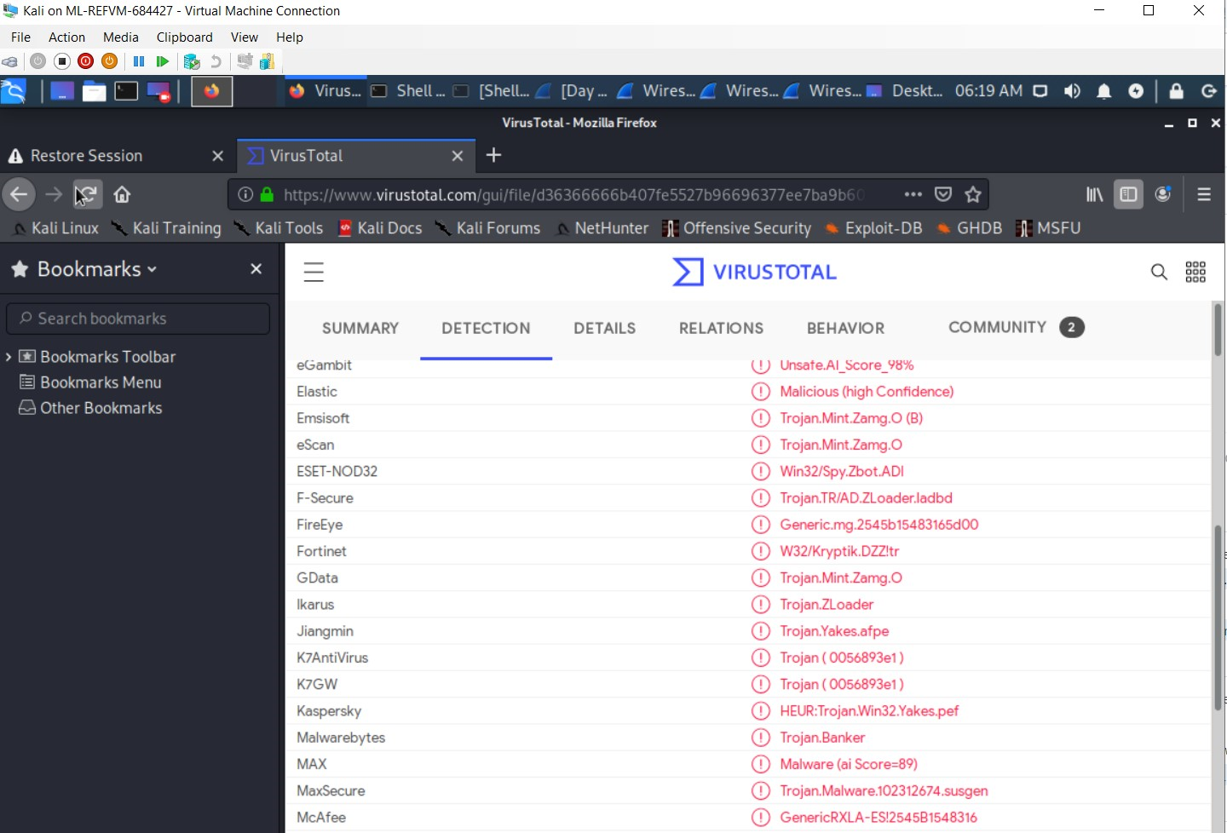
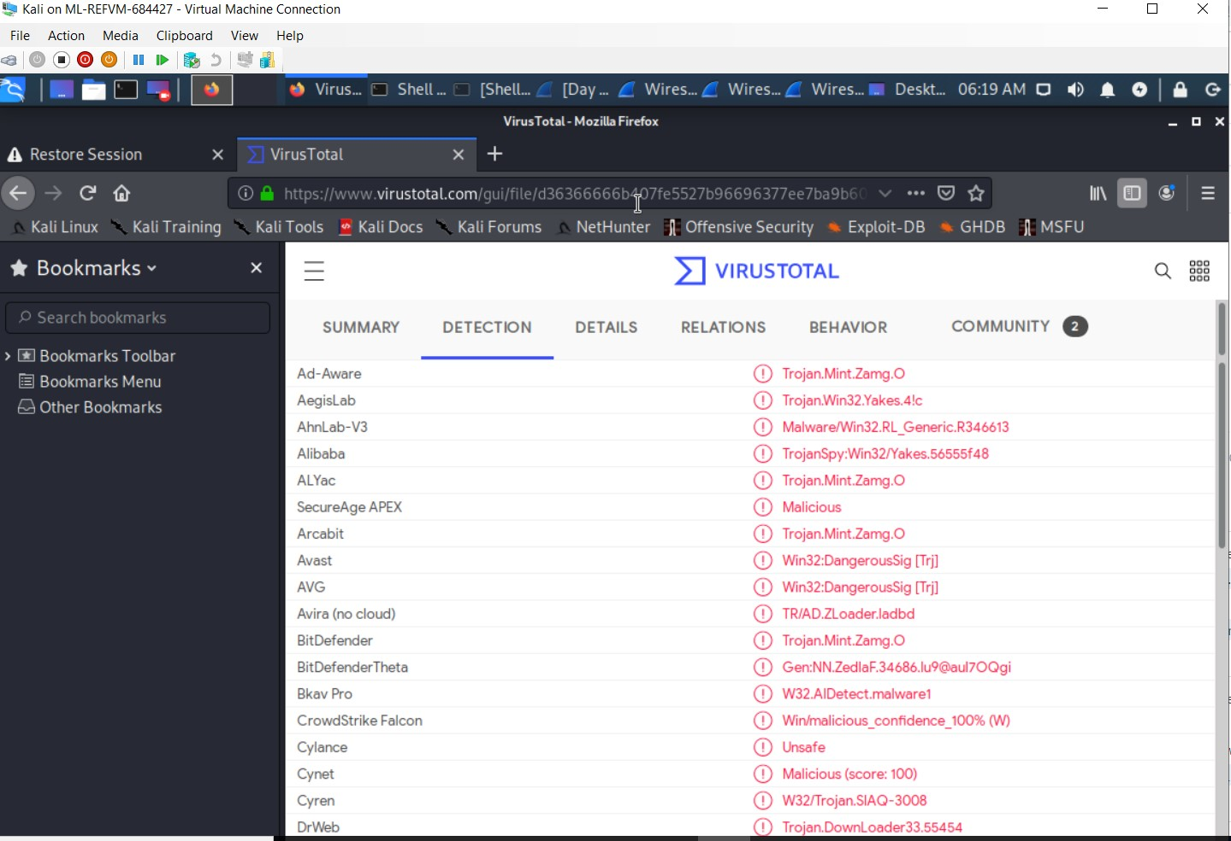
Wireshark-Time Thieves
virustotal.com

Slide 7
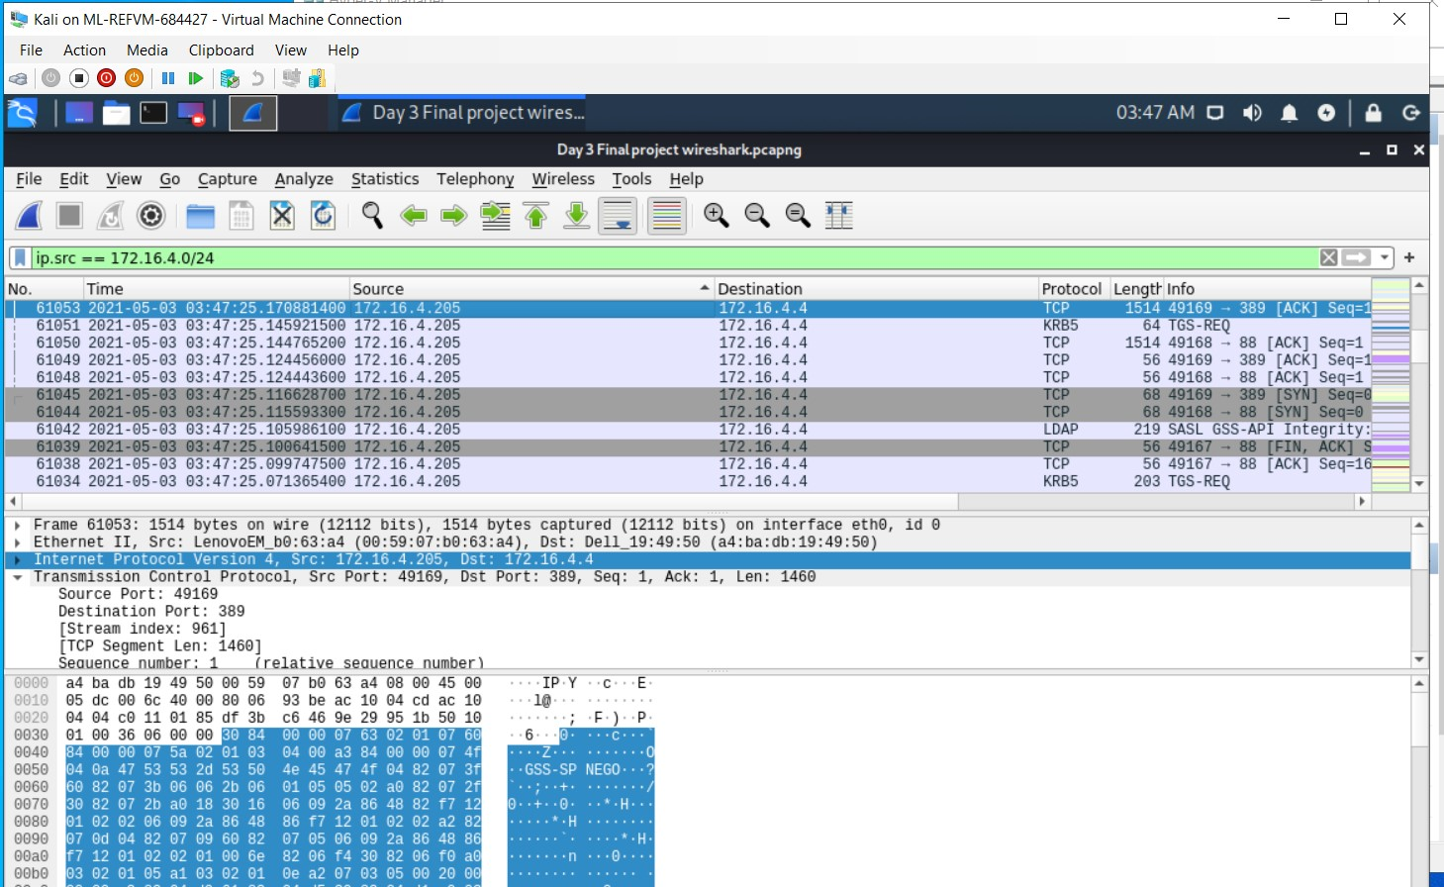
Wireshark-Vulnerable Windows Machines
Wireshark-Vulnerable Windows Machines
Host name:Rotterdam-PC
IP address:172.16.4.205
MAC address:00:59:07:b0:63:a4

Slide 8
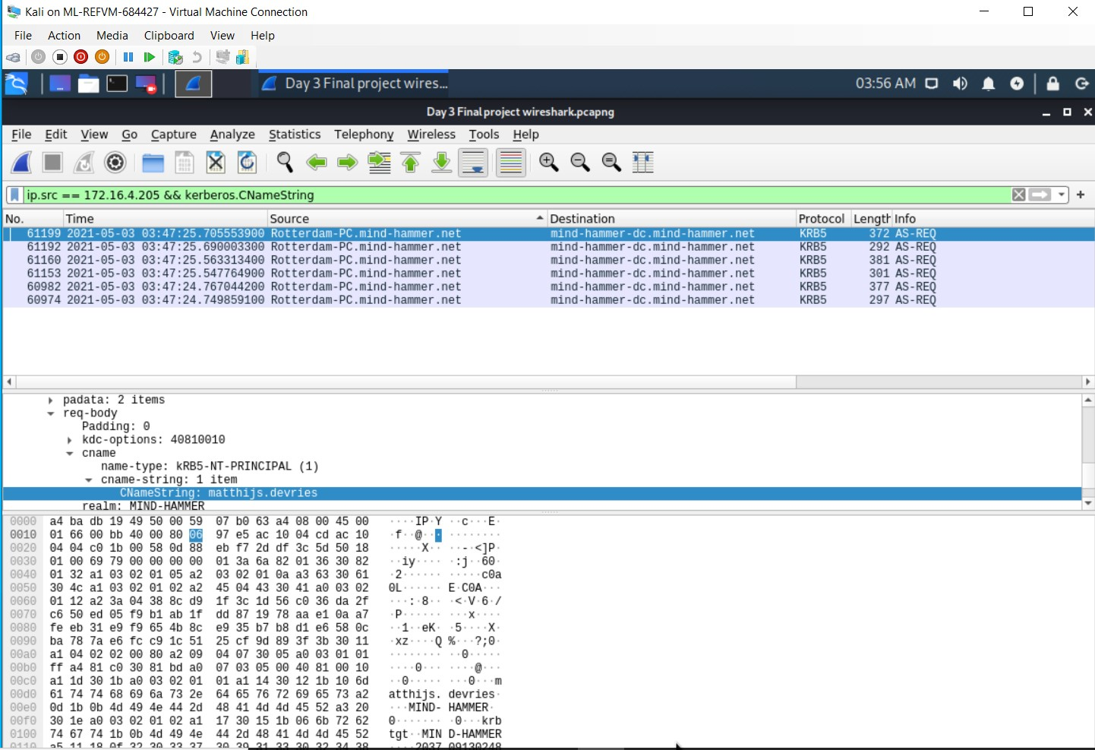
Wireshark-Vulnerable Windows Machines
ip.src==172.16.4.205 && kerberos.CNameString
Windows User: mattijs.dervies

Slide 9
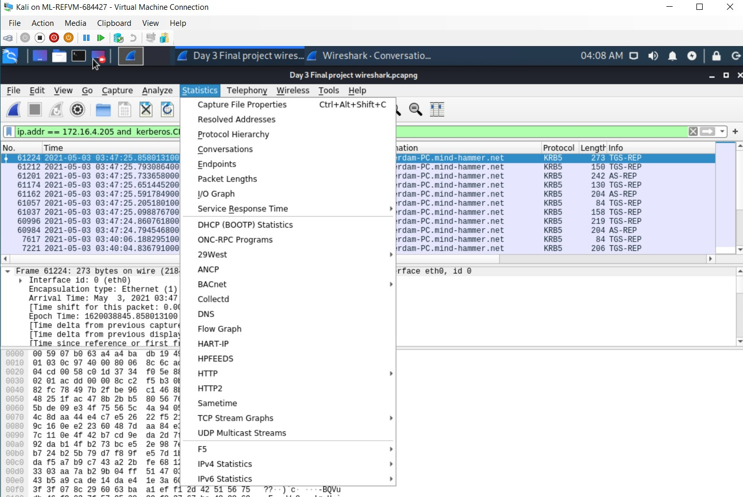
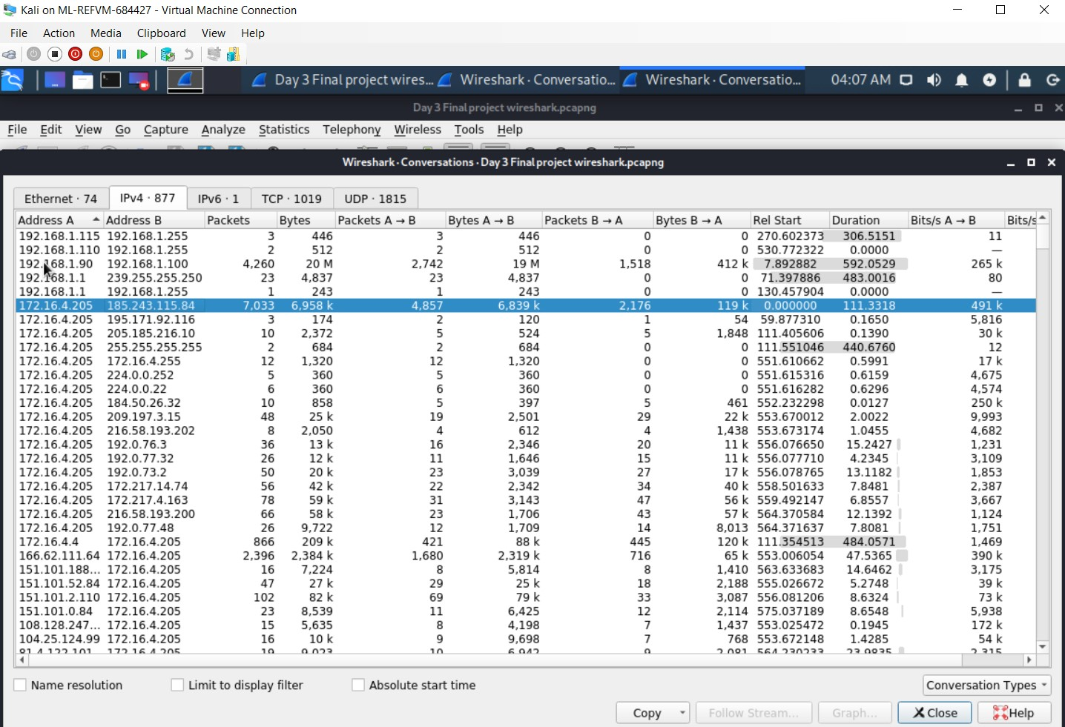
Wireshark-Vulnerable Windows Machines
Statistics-Conversations
IP Address used in infection traffic 185.243.115.84

Slide 10
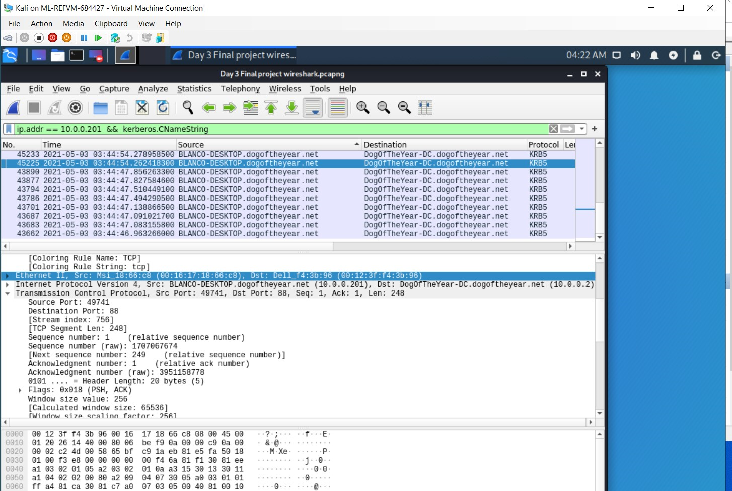
Wireshark-Illegal Downloads
ip.src==10.0.0.201 && kerberos.CNameString
MAC address: 00:16:17:18:66:c8
Windows username: elmer.blanco
OS version : WINDOWS NT 10.0; win64; x64

Slide 11
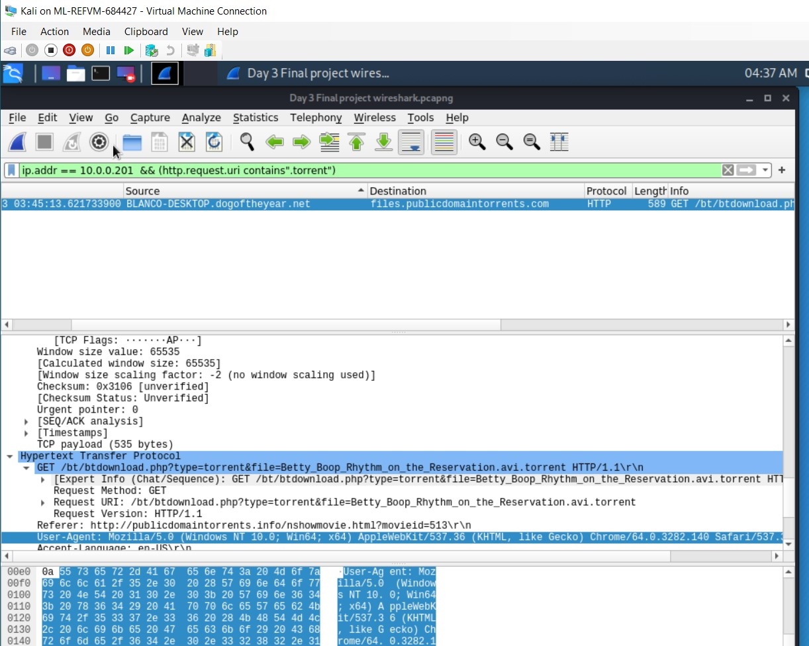
Wireshark-Illegal Downloads
ip.src==10.0.0.201 && (http.request.uri contains “.torrent”)
Downloaded torrent file: Betty_Boop_Rhythm_on_the_Reservation.avi.torrent

Slide 12
Malicious Activity
Activity capture user access the Domain Name: frank-n-ted using the TCP protocol of port 80. The activity was during the business hours.
Watching YouTube
Downloaded torrent file: Betty_Boop_Rhythm_on_the_Reservation.avi.torrent

Slide 13
Questions?

Slide 14
Thank you
Presentation by:
Lucas Domanski
Eric Loi
Md Iftakhger Hossain

Slide 15
The End

